Slide 1


WEB TECH PROJECT
on Service Provider Website
22it3009 Arnav Sao

Slide 2

Project Overview
The project entails constructing a service provider website employing HTML, CSS, JavaScript, MongoDB, Node.js, and Express. Users can register or log in, while companies can post their registration forms, detailing their requirements directly on the site.
To implement the sign-up and login functionality, we can use the bcrypt library to hash and compare passwords, and the jsonwebtoken library to generate and verify tokens. We can also use the cookie-parser library to parse cookies and set them in the response.

Slide 3

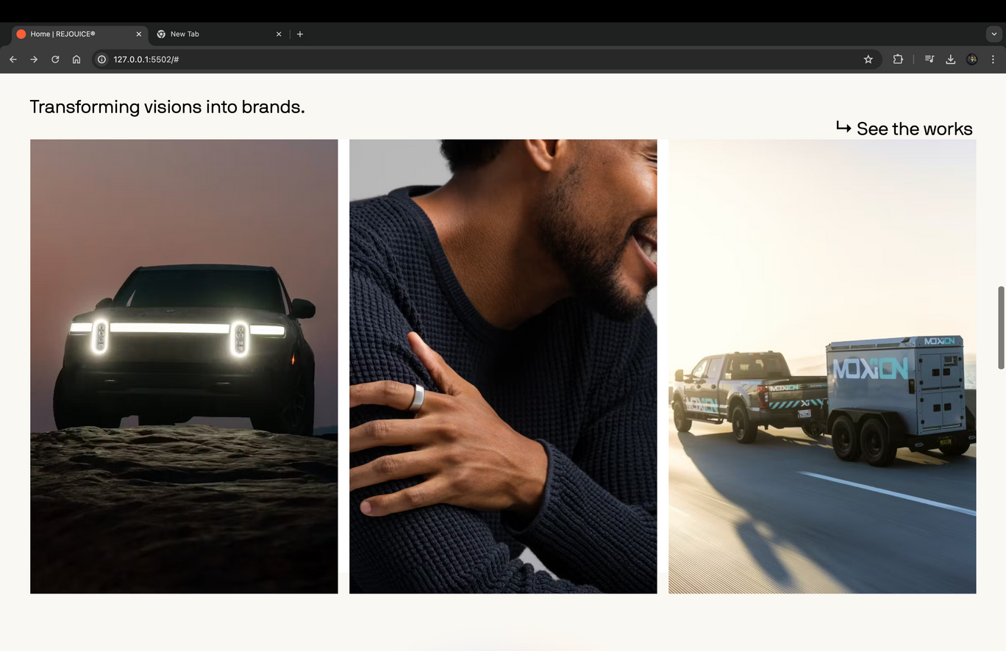
Responsive Website

Slide 4










Technology Stack Used
Frontend
Backend

Slide 5
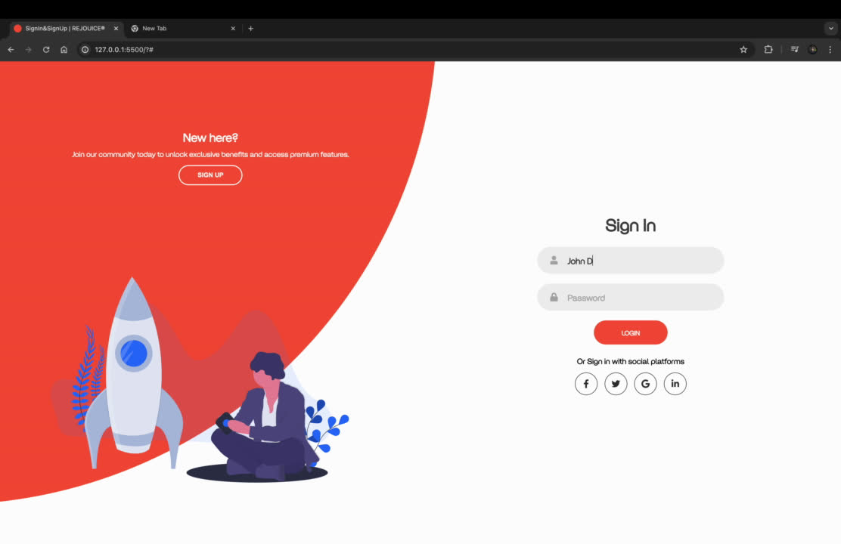

Slide 6
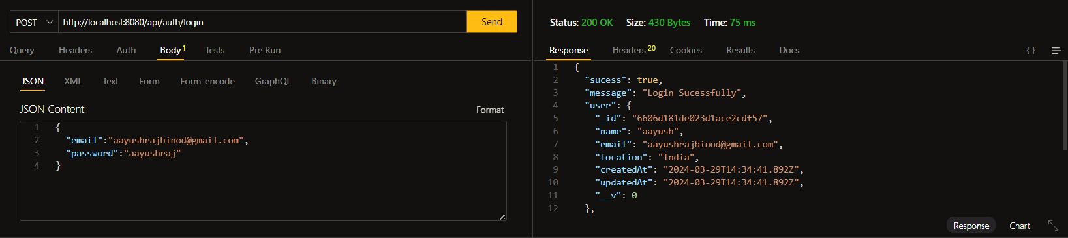
login and authentication

Slide 7
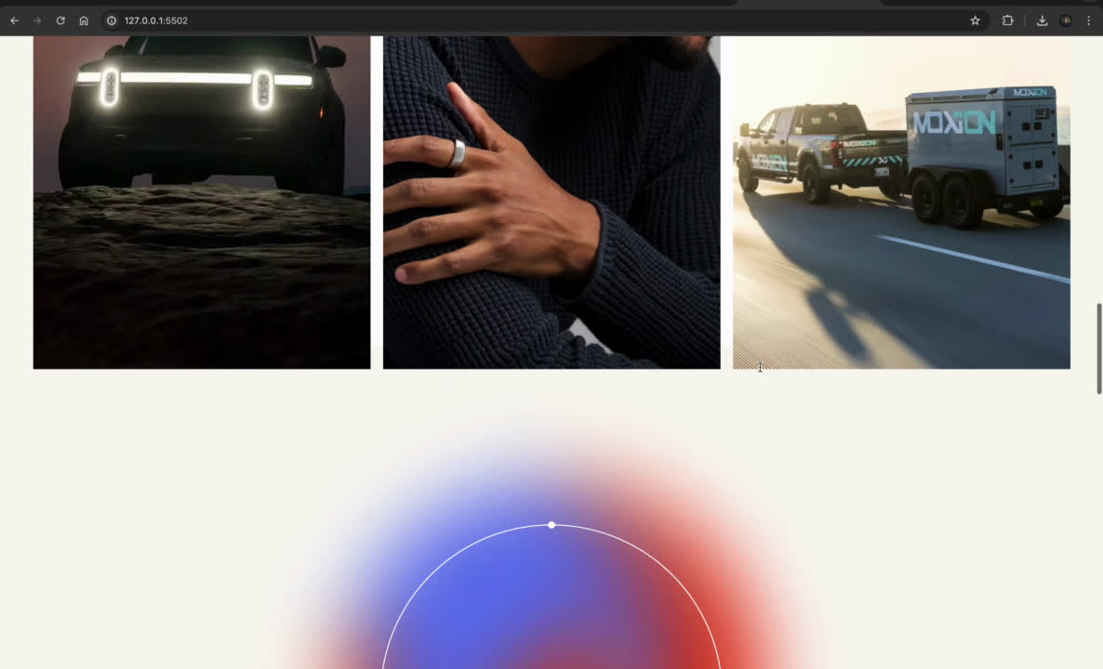
Registration Form

Slide 8

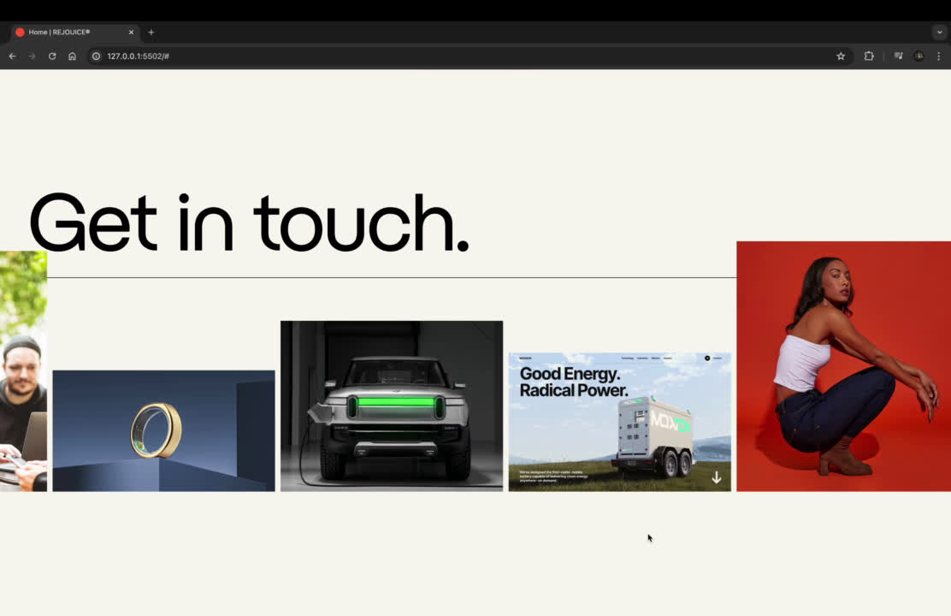
Infinite Scroll
Added infinite scroll trigger using swipper js

Slide 9
Dependencies used in Frontend
Favicon: Utilized for a distinctive shortcut icon.
Locomotive Scroll: Implemented for seamless and fluid scrolling.
Gsap: Incorporated for dynamic and captivating animations.
SVG Images: Employed animated SVG images for visually engaging content.
Swipper.js: Implemented for infinite horizontal scrolling capability.
Preloader: Ensures smooth loading transitions for a polished user experience.
Cursor Effect: Introduces an interactive cursor effect to enhance user engagement and navigation.

Slide 10
Dependencies used in Backend
body-parser: Parsing request bodies.
cors: Cross-origin resource sharing.
dotenv: Environment variables.
express: Web framework.
express-async-errors: Error handling for async functions.
express-mongo-sanitize: MongoDB query sanitization.
express-rate-limit: Rate limiting for requests.
jsonwebtoken: JSON web tokens for authentication.
mongoose: MongoDB object modeling.
morgan: HTTP request logger.
nodemon: Auto-reloading server.
validator: Data validation.
xss-clean: Protection against cross-site scripting.

Slide 11
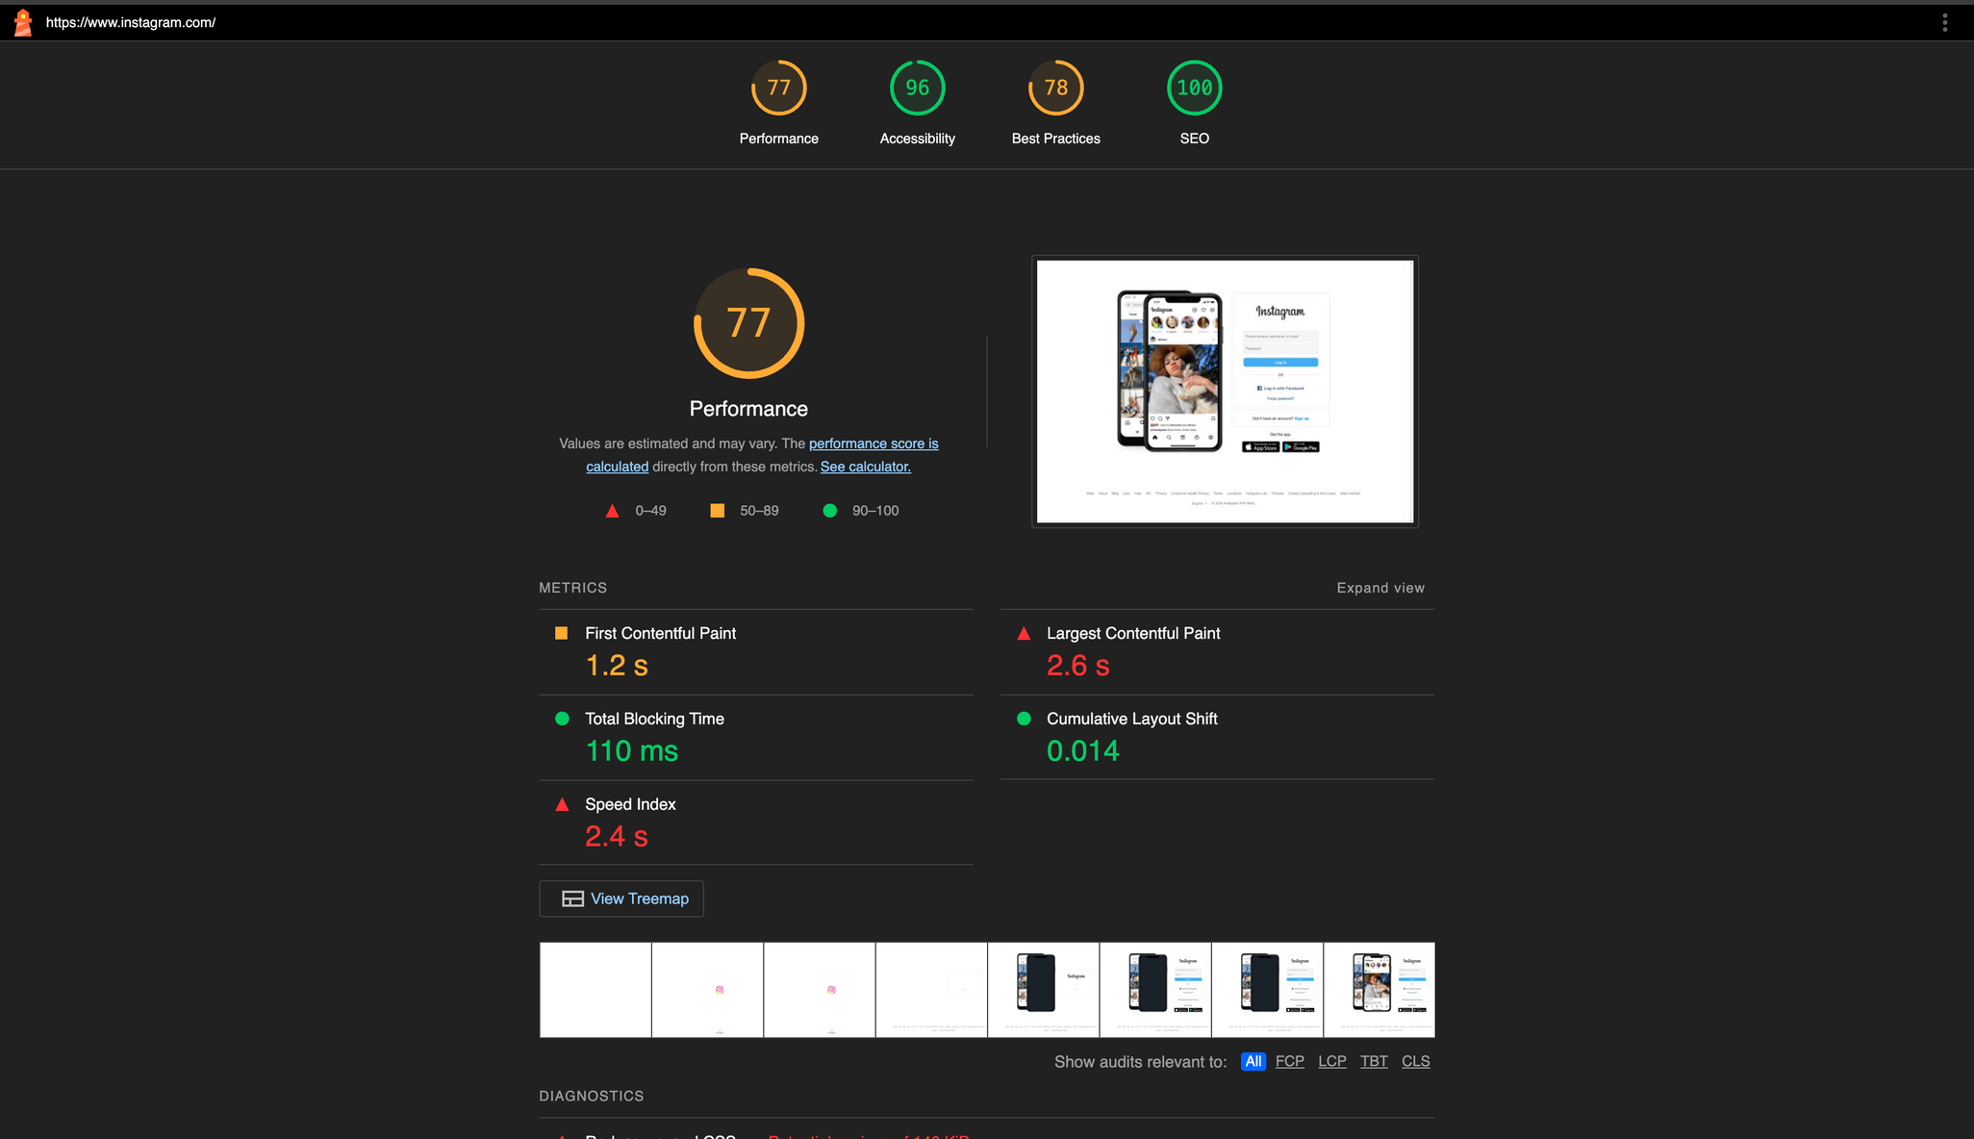
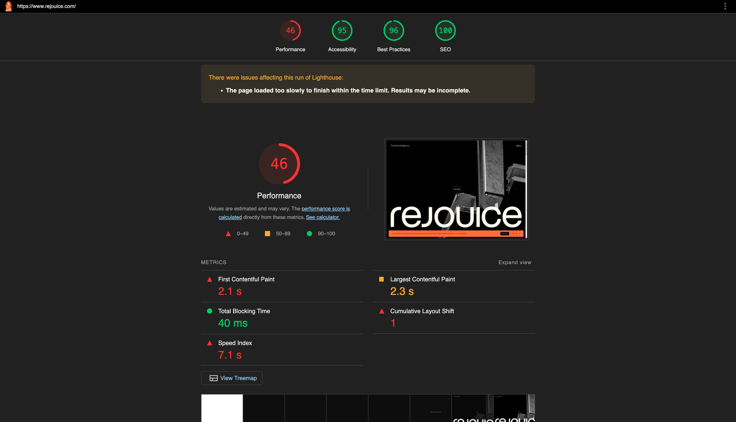
Lighthouse Report

